Slide 1
OPNAV N2N6W4
Allied and Coalition Interoperability
Updated 02 August 2022
2022 Defense Standardization Program Conference

Slide 2
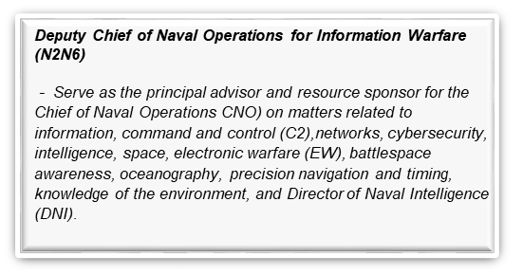
N2N6 Organization
DCNO/DNI/DDCIO-N
VADM Jeffrey Trussler
ADCNO
Mr. Chris Miller, SES
DDNI
Mr. Scott Bray, DISES
Warfighting
Integration
Division
(I)
RADM John Okon
Digital Warfare Office
(DW)
Ms. Kelly McCool
Strategic
Initiatives
Division
(T)
RADM Richard Correll
Enterprise Networks & Cybersecurity
Division
(D)
RDML Susan BryerJoyner
Oceanography & Navigation Division
(E)
RDML Ron Piret
Tactical Networks & C3 Division
(N)
Mr. Claude Barron, SES
Crypto-Electronic & Cyber Warfare Division
(W)
Mr. Bill Flynn, DISES
Intelligence Division
(Q)
Ms. Sandra Brown, DISES
Program Integration (IP) – Mr. Mike Treat (SES)
IW Future Capabilities (IX) – VACANT

Slide 3
Crypto-Electronic & Cyber Warfare Division
(N2N6W)
W DIRECTOR
CRYPTO-ELECTRONIC & CYBER WARFARE DIVISION
Mr. Bill Flynn
(WB) DEPUTY DIRECTOR,
CRYPTO-ELECTRONIC & CYBER WARFARE DIVISION
CAPT Frank Cowan
Div Staff / Deputy OPS / EA
CWO3 Sarah Goodale
WP
PROGRAM INTEGRATION
Mr. Joe Kasperski
WS
MARITIME SPACE CAPABILITIES
CAPT Steve Sollon
WT
IO TRAINING & ISSUES/SRAS
LCDR Martha Wittosch
W1
CYBER WARFARE CAPABILITIES
CAPT Sharon Pinder
W2
SURFACE CRYPTO & ELECTRONIC WARFARE CAPABILITIES
Mr. Cleve Eason
W3
TACTICAL DATA LINKS, COMBAT ID & C-5ISRT CAPABILITIES
CAPT Clay Herring
W4
COALITION INTEROPERABILITY
Cdr Chris Allan
(RN)

Slide 4

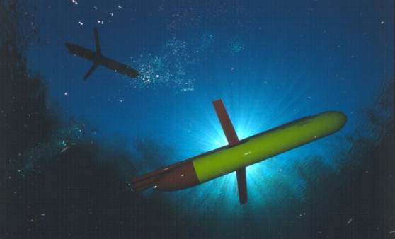
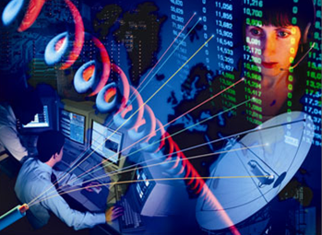
Navy Information Warfare
The integrated employment of Navy’s information-based capabilities (Communications, Networks, Intelligence, Oceanography, Meteorology, Cryptology, Electronic Warfare, Cyberspace Operations, and Space) to degrade, deny, deceive, or destroy an enemy’s information environment or to enhance the effectiveness of friendly operations.
Assured C2
Robust Nuclear C3
Naval Tactical Grid
  Ability to fight in Denied, Disconnected, Intermittent, Limited (D-DIL) environments
  Cyber Resiliency
Battlespace Awareness
Maximize data exploitation and knowledge of the adversary
Automated ISR Processing
Superior knowledge and understanding of the physical environment
Precision Positioning, Navigation and Timing
Advance readiness & resiliency across all IW lines of effort
Integrated Fires
Develop Counter-C4ISR capabilities
Deliver Offensive Cyber tools
Deliver electromagnetic effects
Increase range and lethality of kinetic effects
UNCLASSIFIED//FOUO

Slide 5
OPNAV N2N6W4
Mission & Functions
Promote enhanced Maritime Information Warfare (MIW) interoperability with partner nations through a variety of bilateral and multilateral fora
  Prioritize key international partnerships through information sharing, interoperability initiatives, exercises, experimentation, and combined operations
Foster information sharing and capabilities that enable the warfighter to successfully complete missions across the spectrum of joint and combined military operations
Expand and Strengthen our Network of Mission Partners
    Deepen operational relationships with the other services, agencies, allies, and industry who operate in the maritime environment or have shared interests
    Deliver assured interoperability, integrated fires, and battlespace awareness capabilities seamlessly enabling “fight tonight”
OPNAV N2N6 Partner Engagement Aligns with 2018 National Defense Strategy

Slide 6
N2N6W4 Manpower
W4 Branch Head: Cdr Chris Allan, RN (PEP)
W4 Deputy: Mr. David Flowers
AUSCANNZUKUS Staff Officer: LCdr Travis Moore, RCN (LNO)
AUSCANNZUKUS Experimentation: LCdr Mike Dempsey, RCN (LNO)
2 USN Active Duty
  LCDR Mike Cilia (1810 – Cryptologist)
  LT John Highsmith (1820 – Information Professional)
2 Contractors
  Mr. George Faustino (M2I2, AUSCANNZUKUS, NATO support)
  Mr. Pat Madden (NATO SME, Lead for U.S. Only tasking)

Slide 7
Guidance from President Joe Biden
Our world is at an inflection point. Global dynamics have shifted. New crises demand our attention. And in this moment of accelerating global challenges — from the pandemic to the climate crisis to nuclear proliferation to the fourth industrial revolution — one thing is certain: we will only succeed in advancing American interests and upholding our universal values by working in common cause with our closest allies and partners, and by renewing our own enduring sources of national strength.
Revitalize America’s unmatched network of alliances and partnerships.

Slide 8
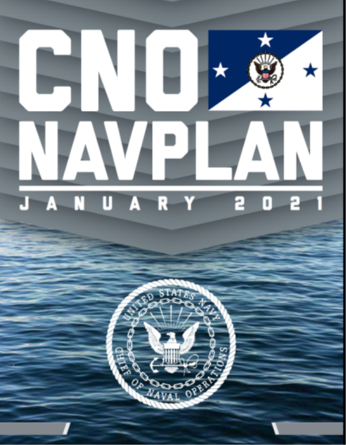
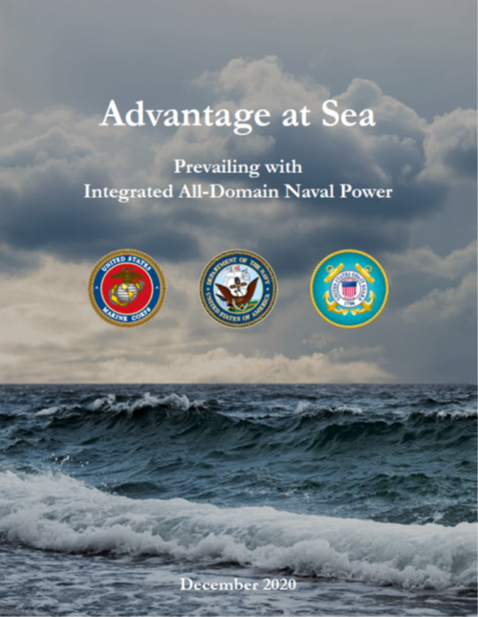
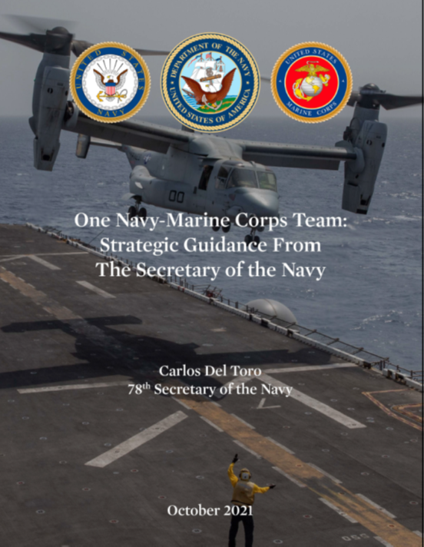
The Navy’s Strategic
Direction Remains Clear
We will seek to operate interchangeably with key allies and partners to control the seas and project power in contested spaces.
We must strengthen our alliances and partnerships— our key strategic advantage in this long-term strategic competition—and achieve unity of effort.
The DON’s partnerships – internally and among our global network of naval allies and partners – provide an unmatched and irreplaceable advantage

Slide 9
N2N6W4 Major Lines of Effort
AUSCANNZUKUS (A-Z) – Five Eyes Maritime Information Warfare (MIW)
  Established after World War II to maintain communications standards between the Allies
  Leads FVEY MIW experimentation to enhance interoperability
  A-Z Supervisory Board is always Chaired by DCNO N2N6
Multinational Maritime Information Interoperability (M2I2) Services Board
  OPNAV N2N6 hosts biannual CENTRIXS Nations IW Forum to enhance Mission Partner operations
  Attended by all Fleets, CCMDs, NATO, European Union and 30 member nations
NATO:
  N2N6 represent the USN at 3 pivotal NATO C4ISR planning and advisory meetings
  Coalition Warrior Interoperability Experimentation (CWIX)
Bilateral Engagements to include Command and Control Interoperability Boards (CCIB) support.
US-Only efforts:
  Foreign Disclosure, Exceptions to National Disclosure Policy (ENDP), Technology Transfer and Security Assistance Review Board (TTSARB), and others.
Lead Communications and Information Warfare interoperability with coalition partners

Slide 10
AUSCANNZUKUS (A-Z)
W4 organizes and conducts A-Z activity to enable interoperability via a robust battle rhythm of meetings to deliver assured “fight tonight”, “fight through”, and “fight tomorrow” capabilities
  From AO-level Working Groups (Operational, Technical, Experimentation, Cyber Defence and EMW) to O6-level Executive Steering Committee (ESC) to the Flag Officer Supervisory Board (SB)
SB objectives:
  Achieve interoperable and resilient maritime C2 to enable “fight tonight”
  Improve the Information Security and Survivability of Maritime Networks
  Support the development of Maritime Networking in a Denied, Degraded, Intermittent or Limited (D-DIL) communications environment
  Fight and Win in the Electromagnetic Spectrum
  Advance Information Warfare in Warfighting
W4 plans and facilitates engagements every Fall in the Mark Center
  Fall 2022 A-Z working groups and ESC 17-28 Oct
  Focuses on enabling SB objectives and aligning FVEY IW TTPs
SB meetings
  March 2022 in-person meetings held in Canberra, Australia
  DCNO Guidance via the Chairman’s Communique
  DCNO Letter to Chiefs of Navies identifying the need to get after FVEY Interoperability
Authors ACP 202, Communications Interoperability Requirements for Information Exchange (CIRIE) in the Maritime Environment

Slide 11

A-Z Organization and Supporting Groups
Supervisory Board
Flag Level
Permanently Chaired by DCNO N2N6 (3*)
Rotational Chair
Royal Navy
as of APR 2022
Maritime Cryptologic Committee
National SMEs
Rotational Chair
Executive Steering Committee
O6 Level
Rotational Chair
Electromagnetic Maneuver Warfare Working Group
National SMEs
Rotational Chair
Operational Working Group
National SMEs
Rotational Chair
Technical Working Group
National SMEs
Rotational Chair
Cyber Defence Working Group
National SMEs
Rotational Chair
Experimentation Working Group
National SMEs
W4 CAN LNO
All groups met in Canberra in March 2022

Slide 12
Multinational Maritime Information Interoperability (M2I2) Services Board
US-led, biannual engagement provides the only international maritime forum focused on improving interoperability and cooperation on coalition networks
Develops, manages, and implements agreed operational and technical solutions for CENTRIXS-M, BICES, Mission Configurable Networks (MCN), Communities of Interest, and networks deemed a priority for coalition forces
Last met in person 10-14 February 2020 in Wellington, New Zealand
Key topics of discussion included:
  Future Coalition Networking
    Mission Partner Environment (MPE)
    Federated Mission Networking (FMN) – managed by NATO
  Cybersecurity
  National development of IW concepts
  Unclassified Information Sharing Services (All Partner Access Network (APAN))
  Common Operating Picture
  Collaboration at Sea (CaS), SeaVision, Classified Solutions for Commercial
  Operations in a Denied, Degraded, Intermittent and Low (D-DIL) bandwidth environment
  Gray Zone Operations or Hybrid Warfare
  In Wellington, a range of critical topics were discussed in 140+ sidebars
The next M2I2 Board is scheduled for 5-9 September 2022 in Turku, Finland
The Only Maritime Forum Enabling Allied Assured C2

Slide 13
M2I2 22-1 Composition
(Virtual session)
Australia
Belgium
Brazil
Canada
Chile
Colombia
Denmark
Estonia
Finland
France
Germany
Iceland
Indonesia
Italy
Japan
Malaysia
Mexico
Netherlands
New Zealand
Norway
Peru
Philippines
Portugal
Singapore
South Korea
Spain
Sweden
Thailand
United Kingdom
Pending Invites
India
Israel
KSA
Latvia
Lithuania
Morocco
Poland
Tunisia
UAE
US Navy Commands
OPNAV
FFC/CPF
C2F/C3F/C4F/C5F/C6F/
C7F/C10F
NAVIFOR
NAVWAR
NIWC PAC
PEO C4I
CNFJ
TACTRAGRULANT / PAC
NCTAMSPAC/PRNOC
Member Nations
Executive Steering Group
Operations and Training Working Group
Technical and Cyber Working Group
U.S. Commands
AFRICOM
CENTCOM
CYBERCOM
DISA
EUCOM / MARFOREUR
INDOPACOM
JIATF-S
NORTHCOM
SOUTHCOM
OUSD(I)
Joint Staff J6
USCG
DoD CIO
USAF-MPCO
M2I2
Entries in RED attended 22-1
Member Organizations
NATO: Allied Transformation Command (ACT), Allied Command Operations (ACO), NATO Communications and Information Agency (NCIA) and MARCOM CJOS COE, EU Military Staff, ODNI, Centre for Naval Analysis
All regional CCMDs, all numbered Fleets, 30 nations, NATO, EU

Slide 14
NATO
Consultation, Command and Control (C3 ) Concepts and Requirements (Maritime) Capability Team (MC3CaT)
  The MC3CaT supports the delivery of coherent NATO and National C3 capabilities by providing specialist maritime expertise to support the Consultation, Command and Control Board (C3B) and its Capability Panels
  The MC3CaT meets twice a year reporting directly to the C3B to highlight major issues, risks and national concerns/constraints and proposed remedial courses of action
Joint Command and Control Community of Interest (JC2COI)
  Reports to all 3 Major Armament Groups (MAG):
    Air Force (NAFAG), Naval (NNAG) & Army (NAAG)
  MAGs report directly to the Conference of National Armaments Directors (CNAD)
Maritime Information Services Conference (MISC)
  Maritime Functional Services working group chaired by NATO Allied Command Transformation (ACT)
  Semi-annual forum focused on maritime Command and Control Capabilities
  Life extension and maintenance for existing Maritime C2 system (MCCIS)
  Future Maritime Information Services (FMIS) - TRITON

Slide 15
W4 Bilateral Meetings
CNO’s Navy Guidance on Building Alliances and Partners (NGBAP)
W4 provides IW expertise to support OPNAV N3/N5 and N94 partner engagement
  OPNAV N3/N5: Principal advisor to CNO on technology transfer, security assistance, foreign disclosure, and international program policy issues
  OPNAV N94: Senior National Navy Representative (SNNR) for the Office of Naval Research (ONR)
USN/RAN Capabilities and Requirements Steering Group (CRSG)
  Engagement to pursue IW “Interchangeability” with the Royal Australian Navy (RAN)
USN/RN Delivering Combined Seapower (DCS)
  Forum focused on improving maritime “Interchangeability” with the Royal Navy (RN)
USN/Marine Nationale Strategic Interoperability Framework
  Interoperability engagement with the French Navy
USN/Japan Strategy Dialogue Information Warfare Working Group
  Focused on supporting JMSDF IW development

Slide 16
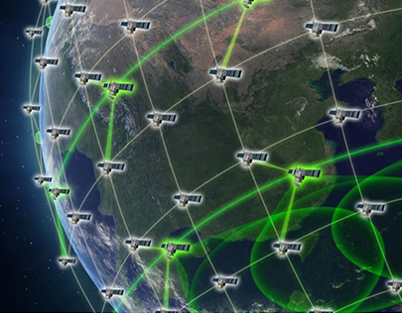
Ongoing C4I Areas of Interest
Mission Partner Environment (MPE)
NATO Federated Mission Networking (FMN)
US BICES (CANES Virtualization)
Pegasus Operationalization with Combined Communications-Electronics Board (CCEB)
Denied – Degraded, Intermittent and Limited (D-DIL) bandwidth environments testing and experimentation
Project Overmatch
Assured PNT
C-C5ISRT
Long range fires/Naval Integrated Fires Element (NIFE) and Tactical Edge Targeting (TET)
Complex, Collaborative Environment

Slide 17
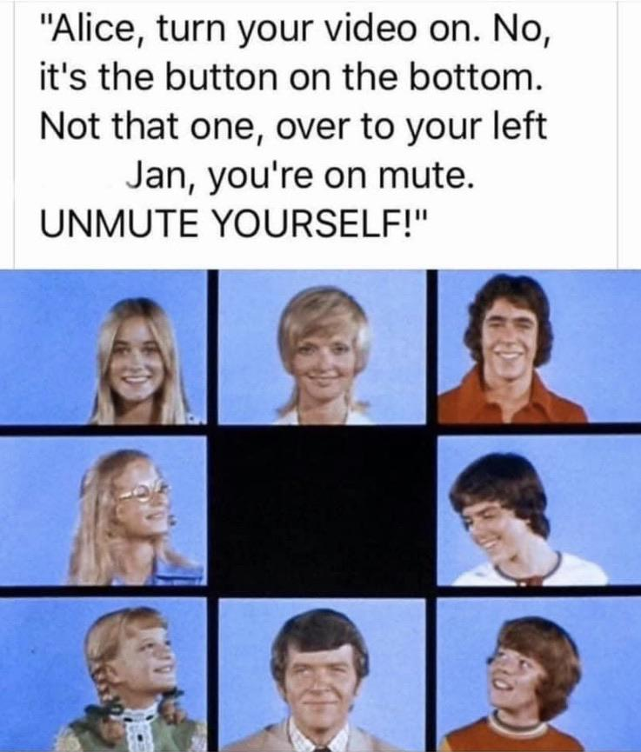
Engagement Plan
  2022
  Mar: AUSCANNZUKUS 22-1/ Australia
  May: RAN/USN CRSG / Australia
  Jun: French Strategy Dialog / France
  Jun: NATO MC3CaT / Netherlands
  Aug: C2IP / Garmisch, Germany
  Aug: RIMPAC (experimentation)
  Sept: M2I2 22-2 / Turku, Finland
  Oct: AUSCANNZUKUS 22-2 / Mark Center
  Oct: PC22 (experimentation)
  Dec: NATO MC3CaT / Brussels
  Dec: FVEY Navy Staff Talks / Canada
  2023
  Feb: M2I2 23-1 / France
  Mar: AUSCANNZUKUS 23-1/ UK
  Sep: M2I2 23-2 / USA
  Oct: AUSCANNZUKUS 23-2 / Mark Center
Three years of COVID Impacts to Multiple Foreign International Engagements

Slide 18
Questions?
The Single biggest problem in communications
is the illusion that it has taken place.
-George Bernard Shaw

